Slide 1

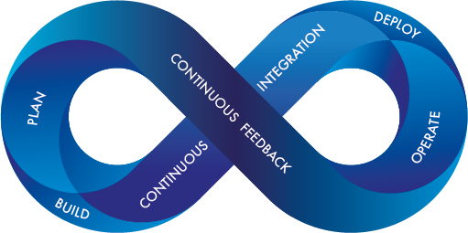

GIT WORKFLOW

Slide 2
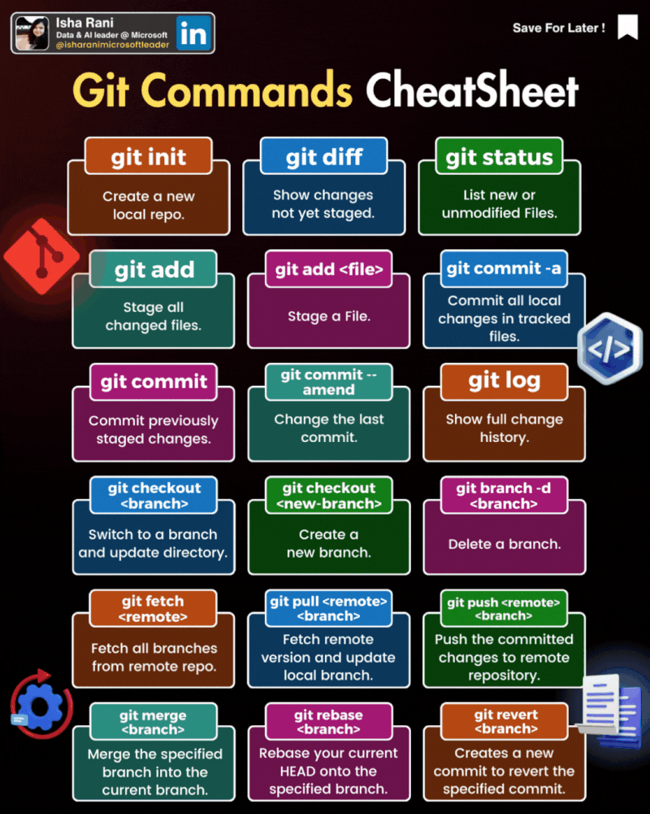
GIT WORKFLOW

Slide 3
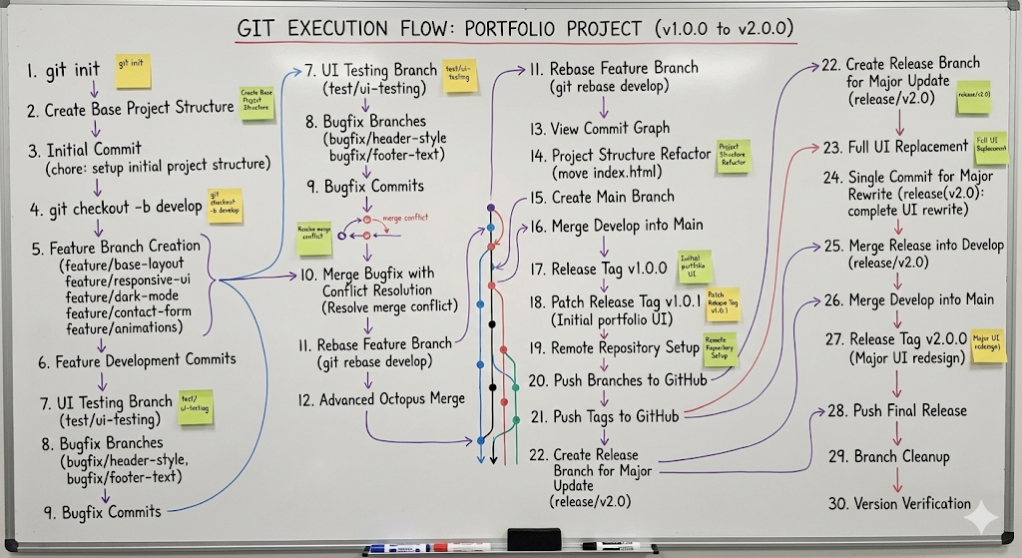
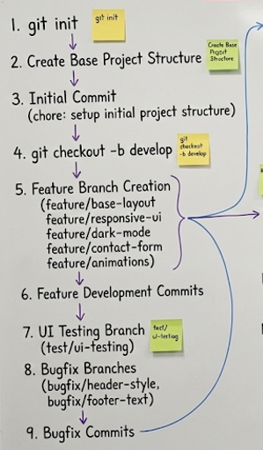
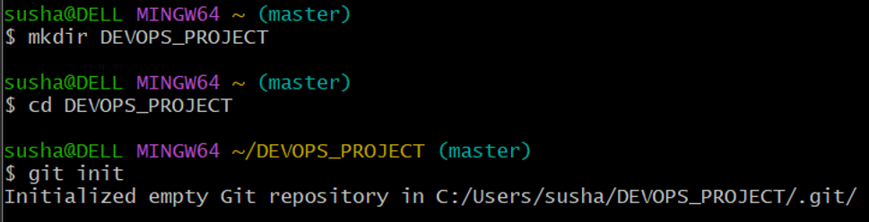
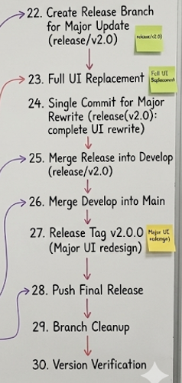
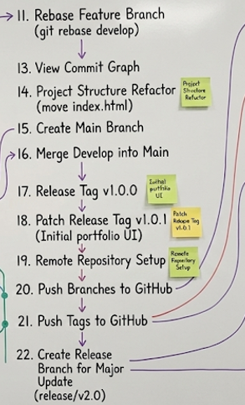
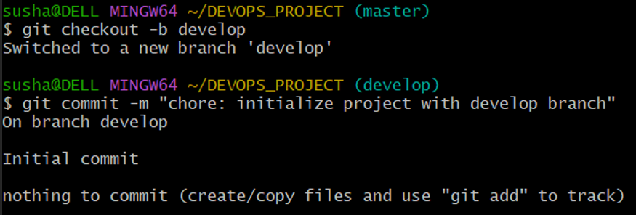
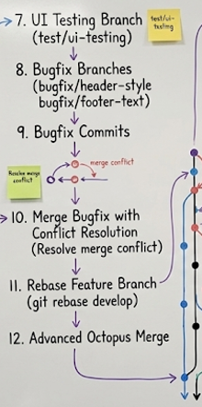
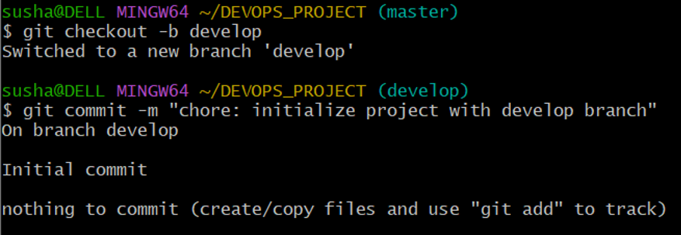
GIT WORKFLOW

Slide 4
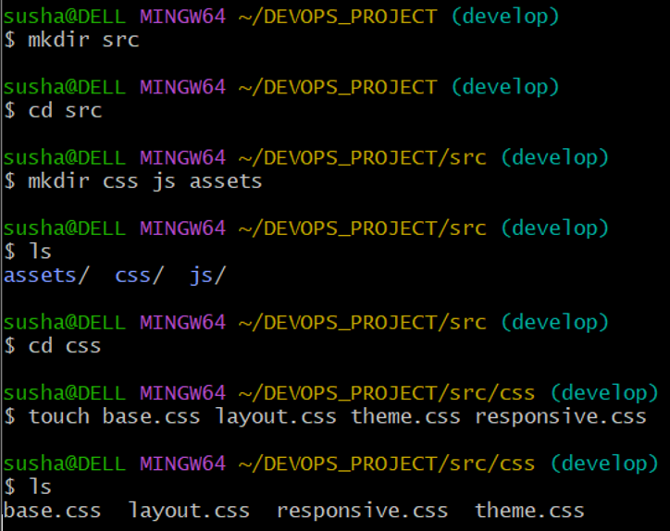
GIT WORKFLOW (git init)

Slide 5
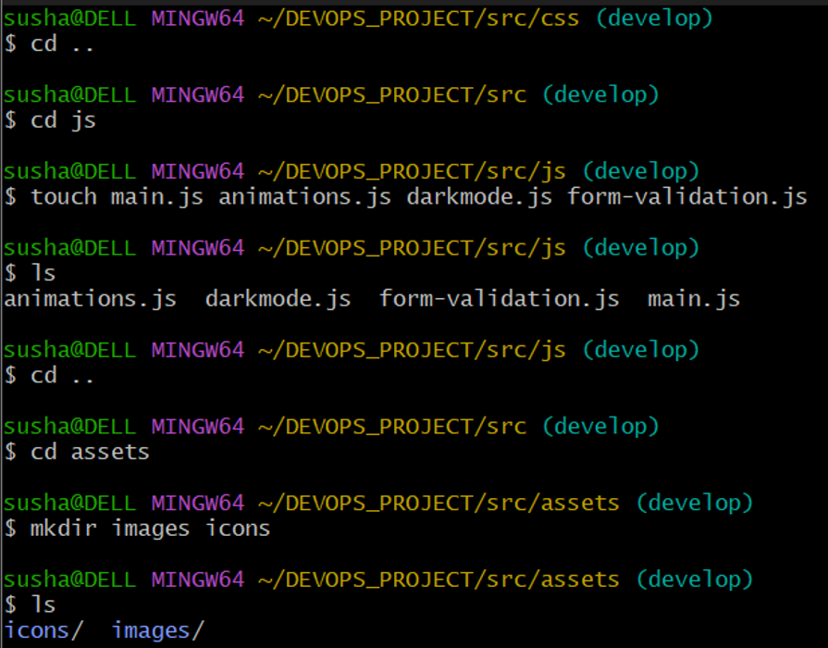
GIT WORKFLOW (Creating Files)

Slide 6
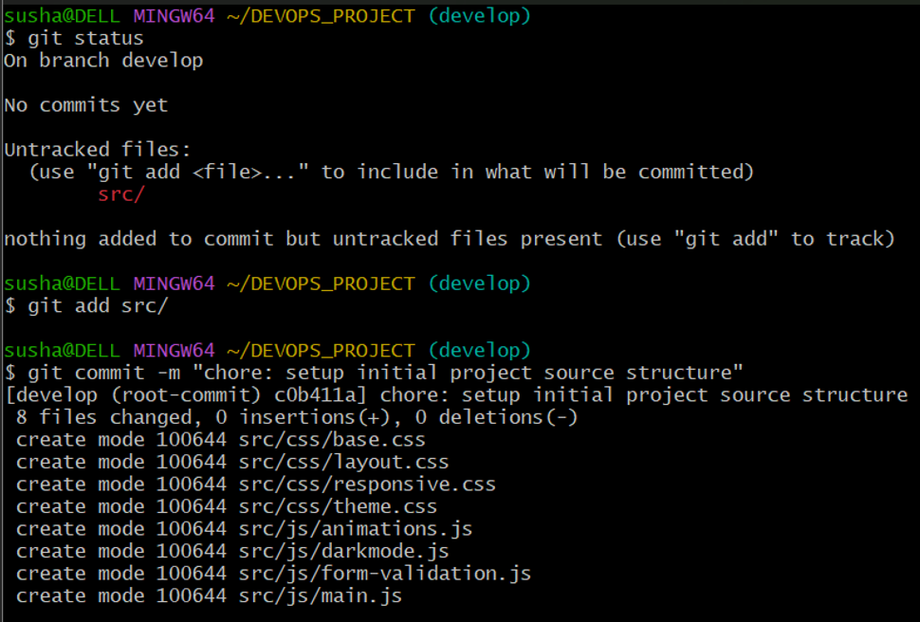
GIT WORKFLOW (Creating Files)

Slide 7
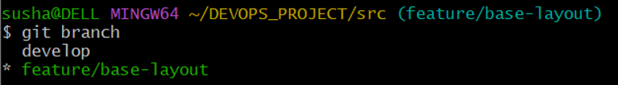
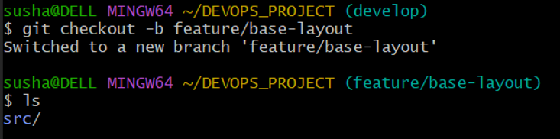
GIT WORKFLOW
(Initial Commit for project setup)

Slide 8
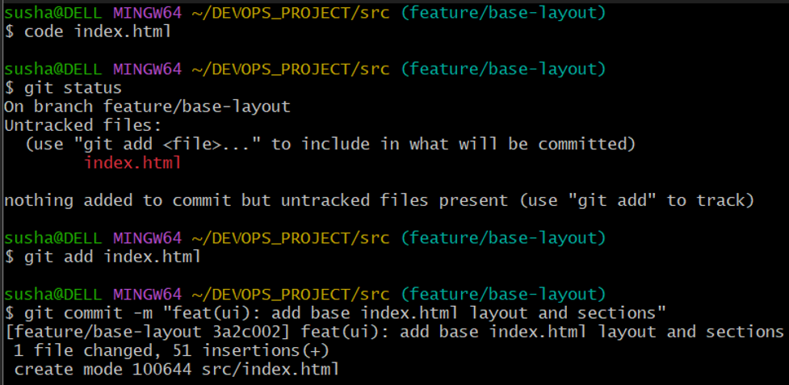
GIT WORKFLOW

Slide 9
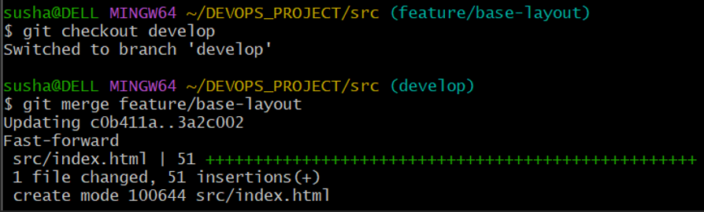
GIT WORKFLOW

Slide 10
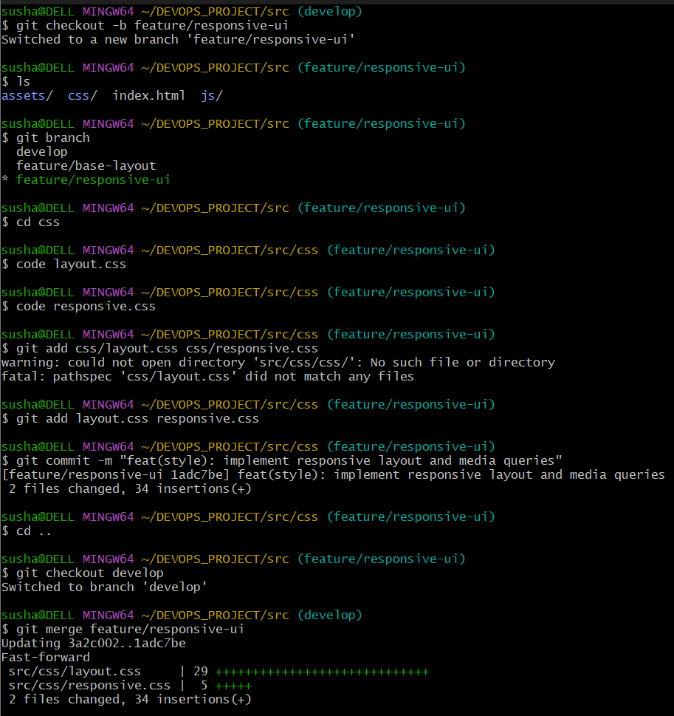
GIT WORKFLOW

Slide 11
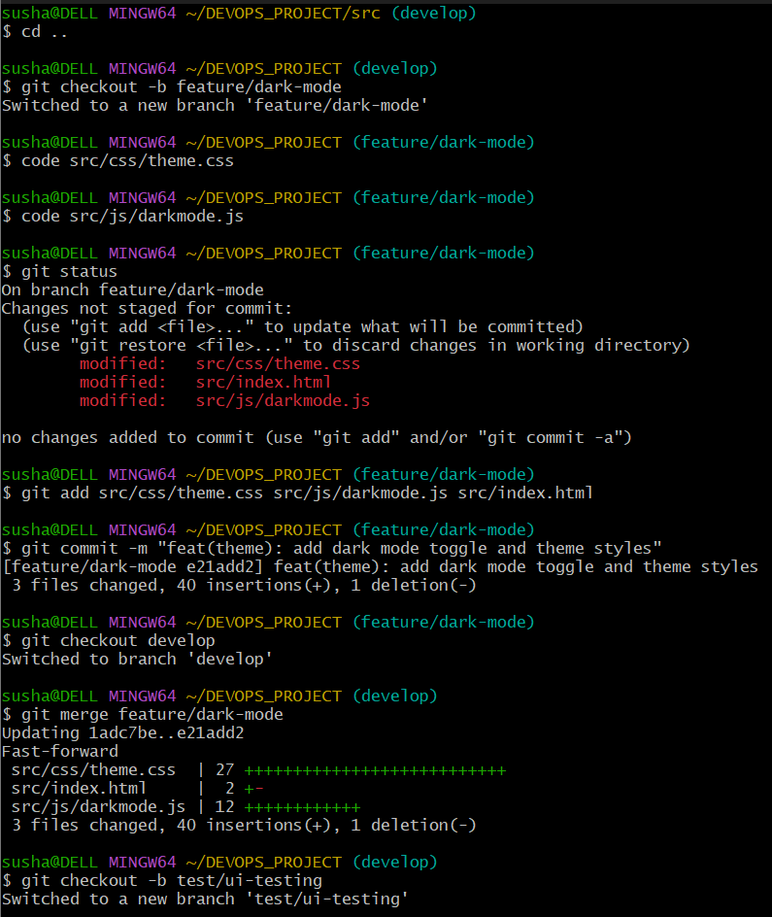
GIT WORKFLOW

Slide 12
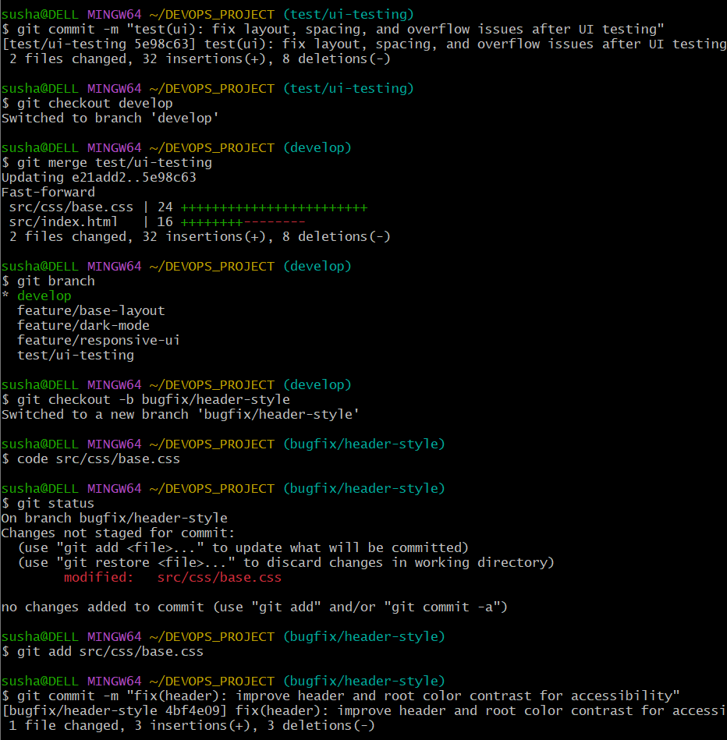
GIT WORKFLOW

Slide 13
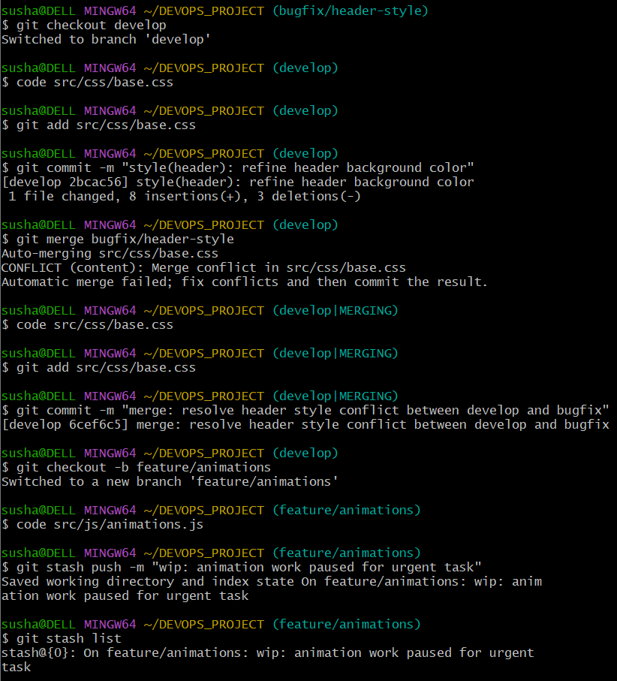
GIT WORKFLOW
(UI Testing and Bug Fixing)

Slide 14
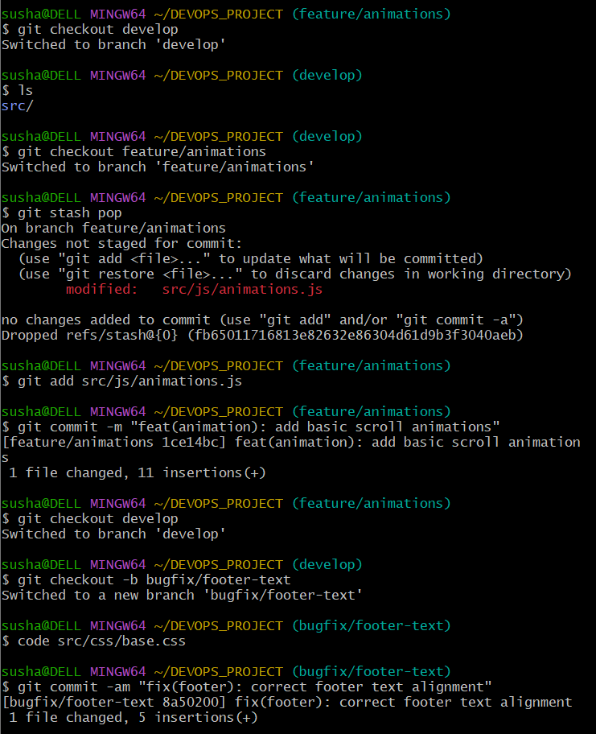
GIT WORKFLOW
(Merge Conflict)

Slide 15
GIT WORKFLOW
(Working with STASH)
SENARIO
Suppose Developing team is working in animation.js.
Immediately they wanted to shift in base.html file which is present in main branch without commit of current branch.
Then we will use stash to store the current work in stack and move to different branch.
Once changes Is done again move to animation branch and can resume the work by using git stash pop command.

Slide 16
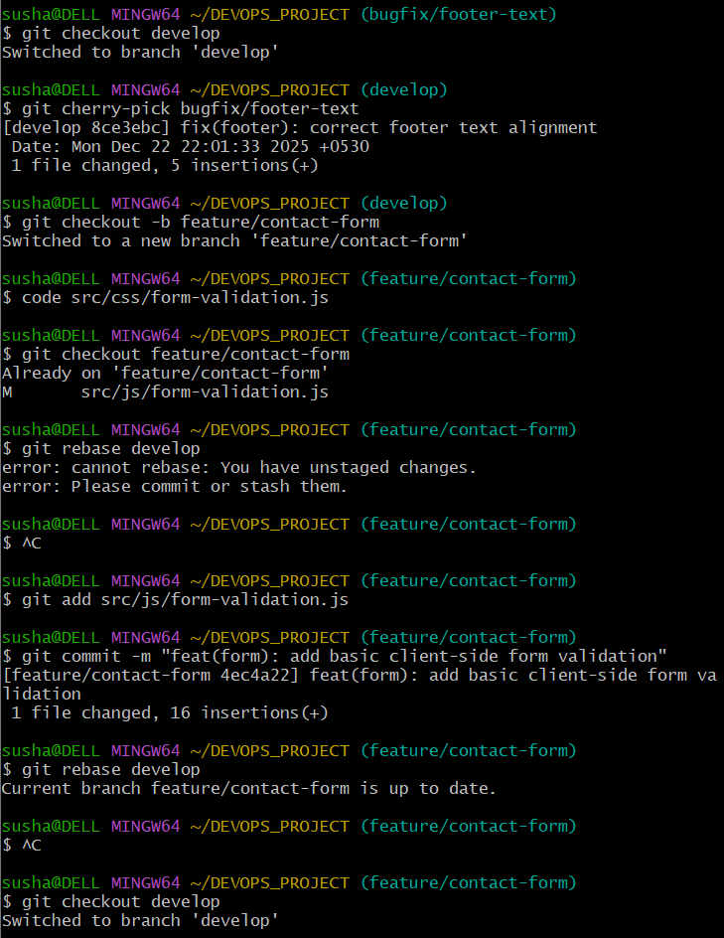
GIT WORKFLOW
(Working with STASH)
SENARIO
Suppose Developing team is working in animation.js.
Immediately they wanted to shift in base.html file which is present in main branch without commit of current branch.
Then we will use stash to store the current work in stack and move to different branch.
Once changes Is done again move to animation branch and can resume the work by using git stash pop command.

Slide 17
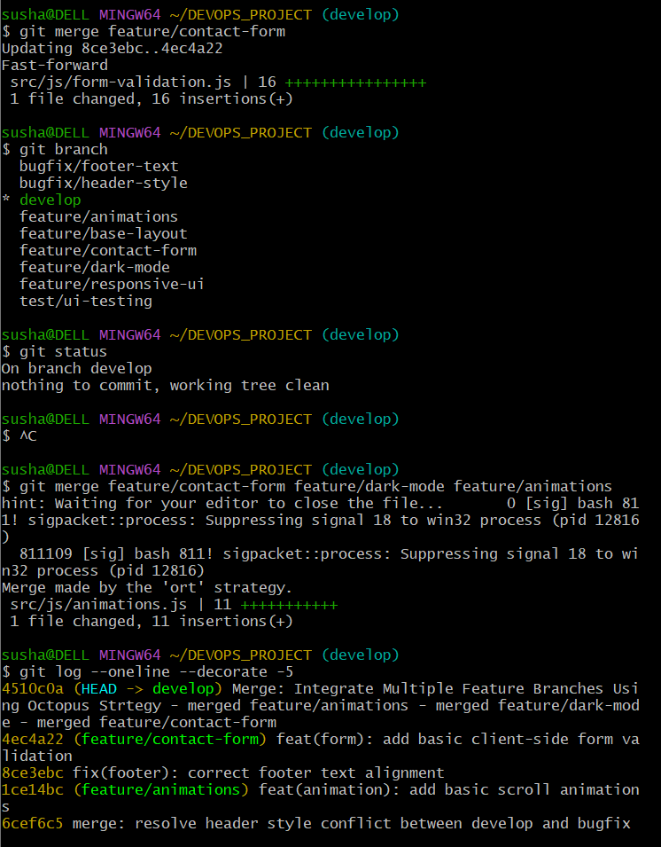
GIT WORKFLOW
(Working with cherry-pick)

Slide 18
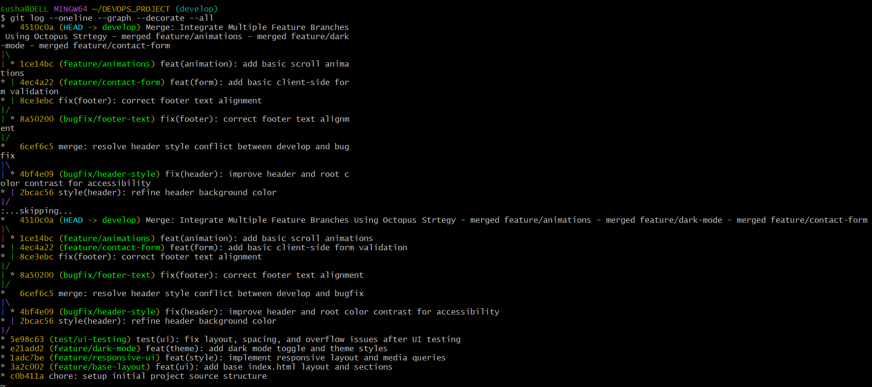
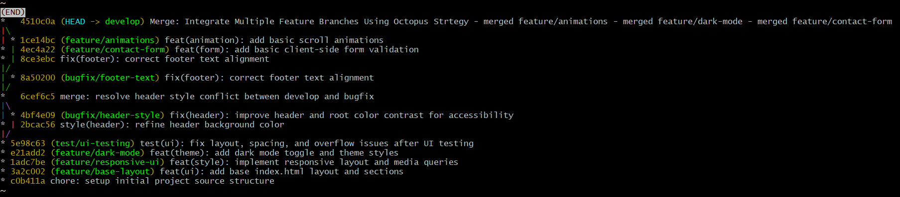
GIT WORKFLOW

Slide 19
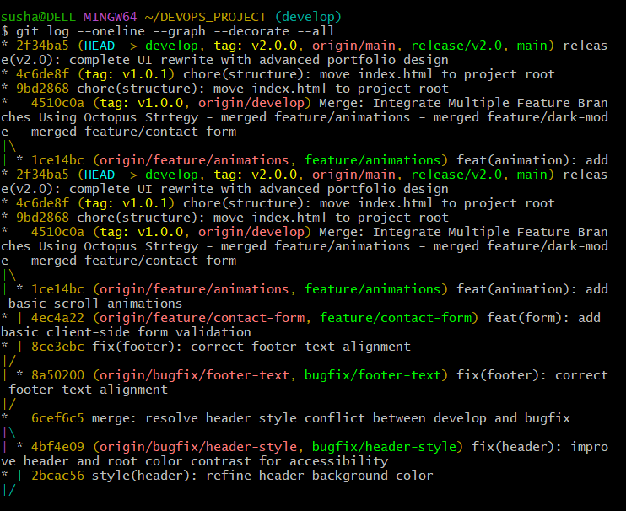
GIT WORKFLOW

Slide 20
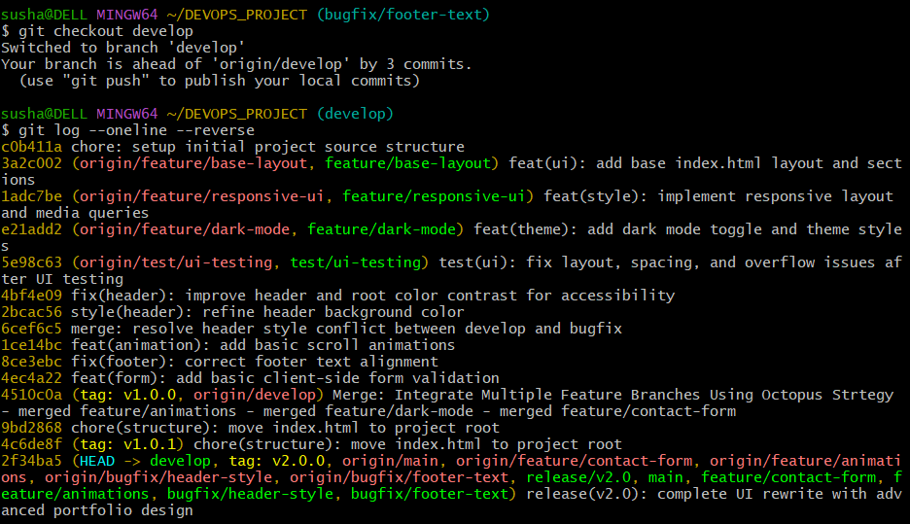
GIT WORKFLOW

Slide 21
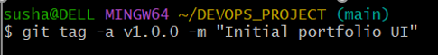
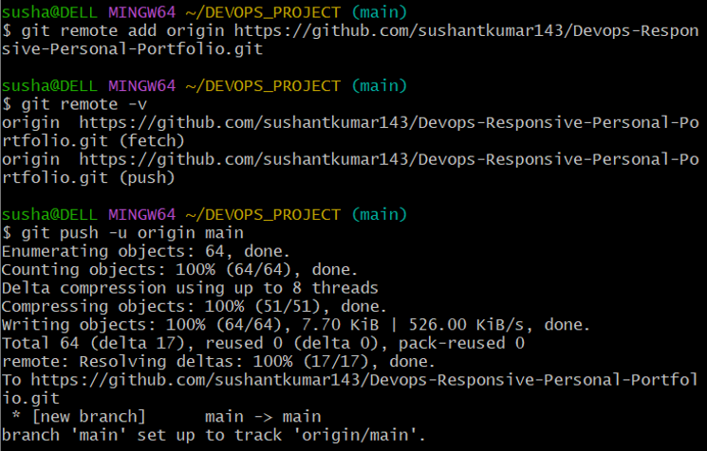
GIT WORKFLOW

Slide 22
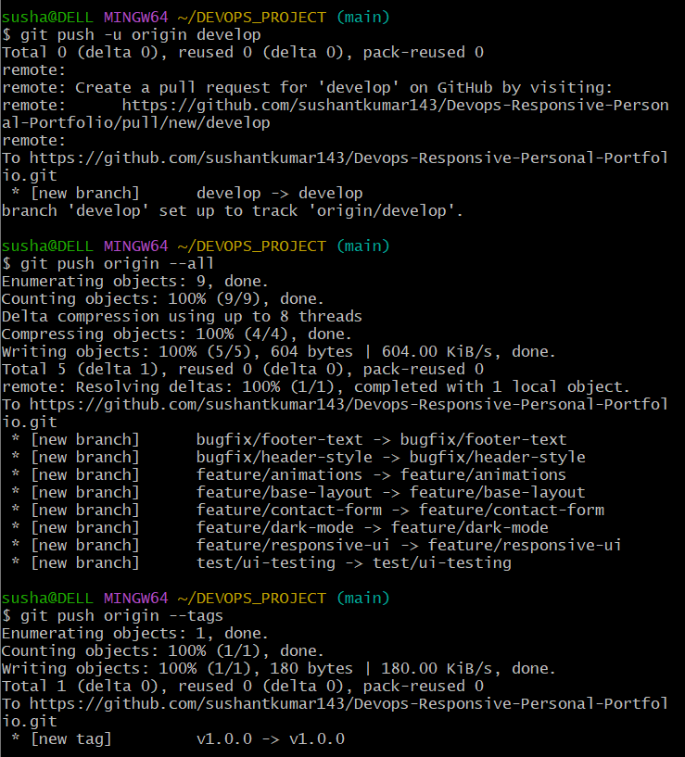
GIT WORKFLOW

Slide 23
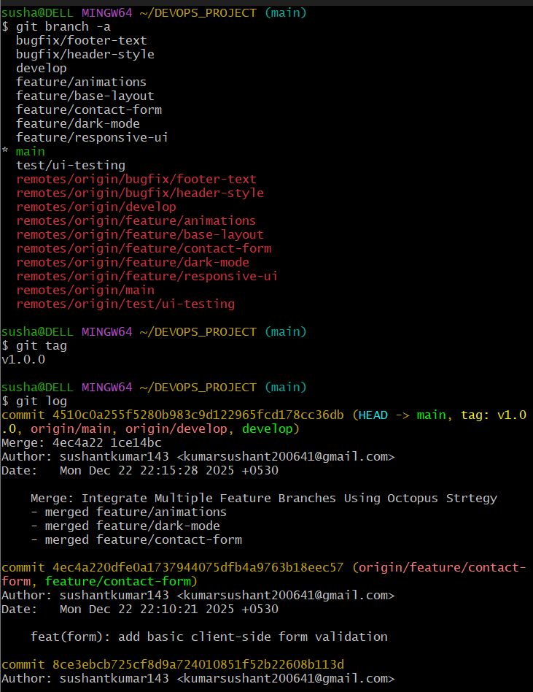
GIT WORKFLOW

Slide 24
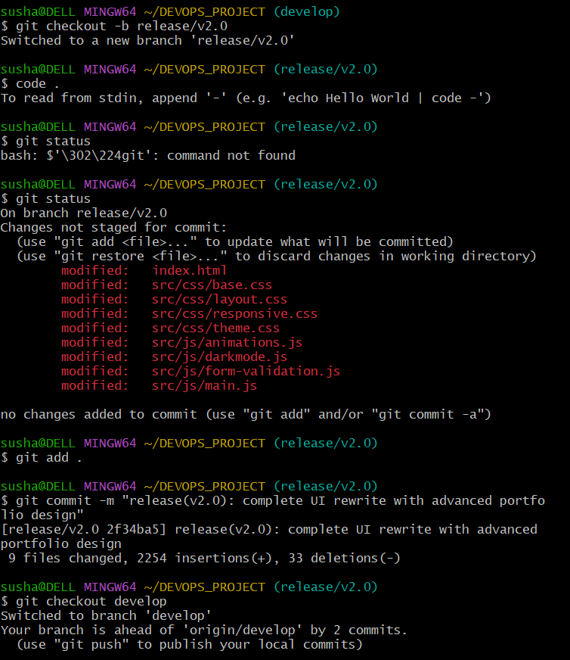
GIT WORKFLOW

Slide 25
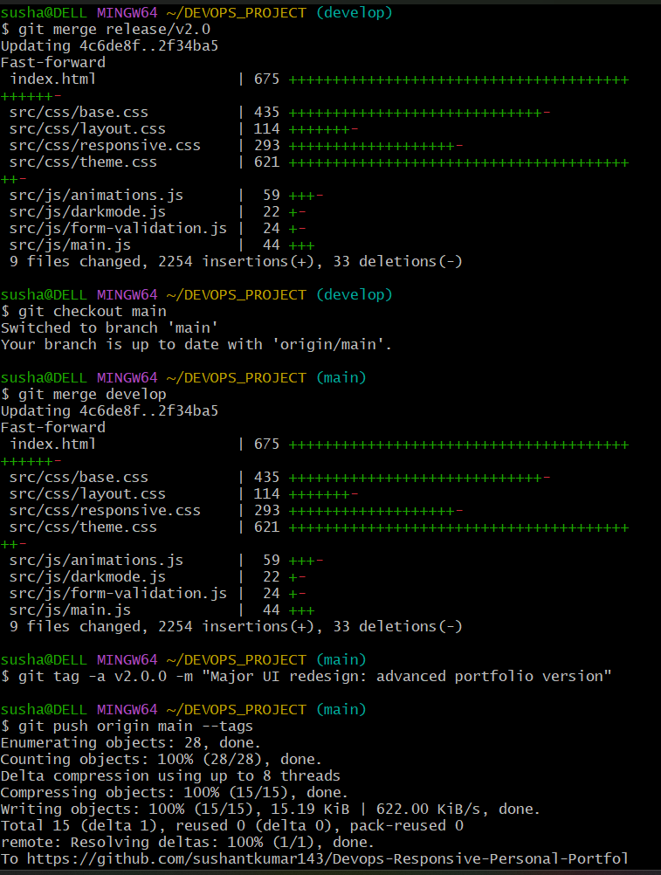
GIT WORKFLOW

Slide 26
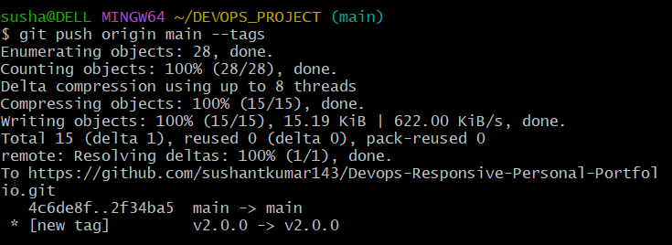
GIT WORKFLOW

Slide 27
GIT WORKFLOW

Slide 28
GIT WORKFLOW
Base Layout
Responsive
Dark Mode
Animations
Contact Form
Feature Branches

Slide 29
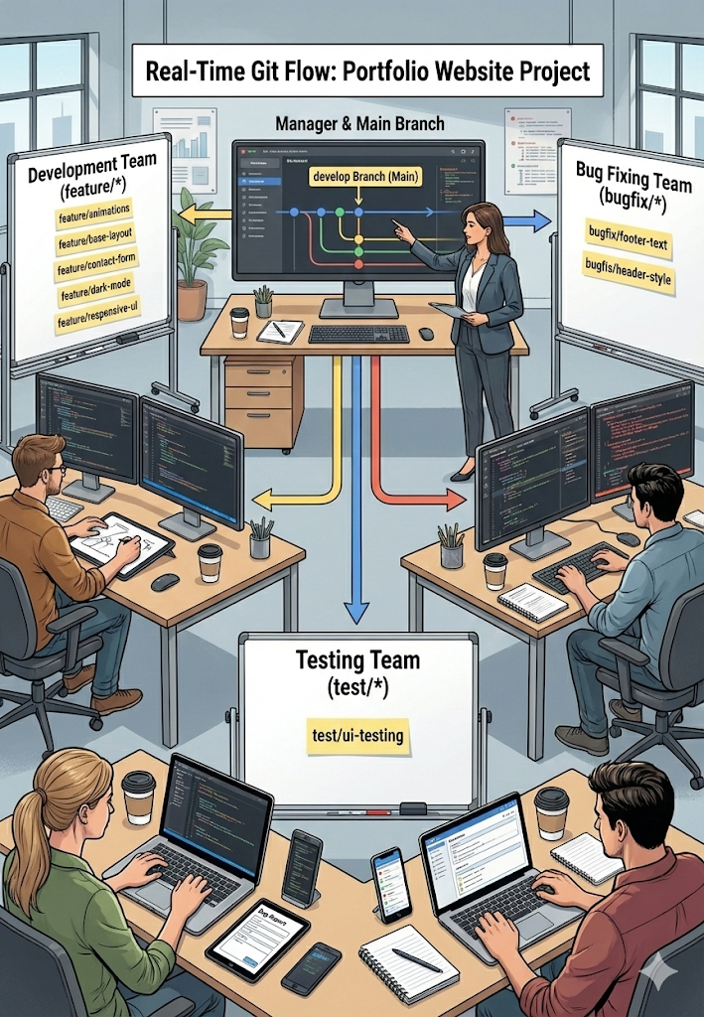
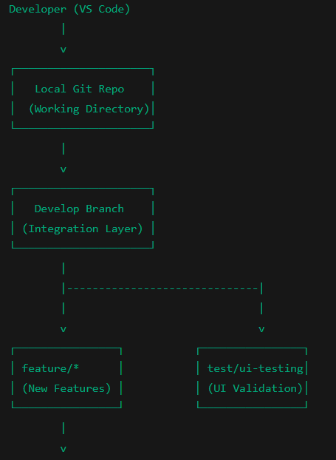
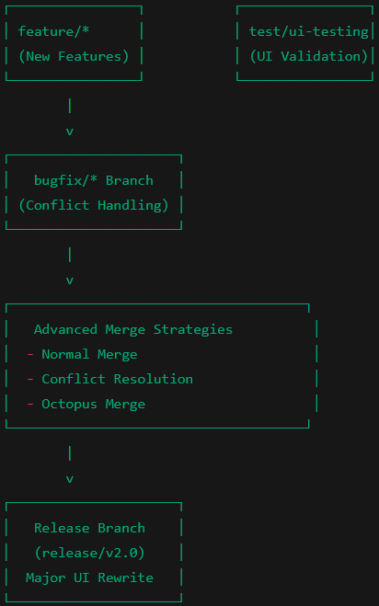
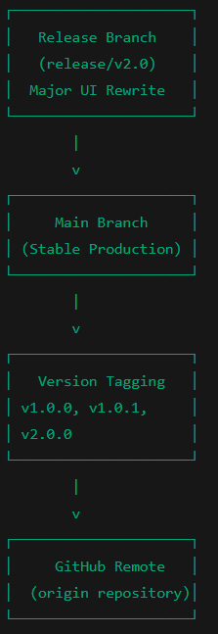
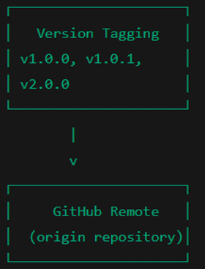
SYSTEM ARCHITECTURE

Slide 30
Stashing
Version Control System
Rebasing
Merging
Push/Pull
Octopus Merging
Fast-Forward Merge
Cloning
Release
Cherry-Pick
Merge Conflict
Commit
Git
Tags

